Slide 1
Prediction of Duplicate Bug Reports
Presented by : Mayuresh Nene, Prasad Chavan, Ryan Chui

Slide 2

Agenda
Problem definition
Datasets
Solution
Preprocessing
Results
Validation
Limitations

Slide 3

Problem Definition
Bug reporting and fixing is a continuous process.
Fixing bugs is a time-consuming process.
Multiple users might report the same bug unknowingly.
Developers spend 75% of their time fixing bugs.
Increases inefficiencies.

Slide 4
Datasets
Three different datasets -
Eclipse contains 46910 data points (
34,223 Non-duplicates and 12,668 Duplicates).
Mozilla contains 60906 data points
(36,834 Non-duplicates and 24,072 Duplicates).
Thunderbird contains 14265 data points
(9906 Non-duplicates and 4359 Duplicates).
Combined total of 122,441 data points (80,963 Non-duplicates and 41,099).
We merged all three datasets into one huge dataset and ran experiments on it.

Slide 5
Solution to the Problem
Input
Algorithm
Output
Duplicate Data
Non Duplicate Data
Preprocessing
Model I
Model II
NLTK

Slide 6
Before Preprocessing
in the example page see url i have tried to vertically align all the cells using col valigntop mac mozilla . and win firefox . both demonstrate this problem so it seems to be quite an old issue. it might be related to bug though i dont believe that dealt with valign. the page httptelcontar.netmiscplugins also shows that col wont apply background colours to cells either as well as not supporting valign the whole left column is meant to be green but mozfirefox wont display the colour this is possibly bug . i have tried to use css instead using verticalalign instead of valign i tried applying styleverticalalign top to the col tags as a workaround in case this issue is due to a lack of support for outdated html . properties and this did not work either col seems to not apply any formatting to cells whatsoever neither css nor html .. microsoft ie .. for the macintosh also displays the valign issue no support for either form of vertical alignment in col but icab b mac browser handles valign correctly not tried it with verticalalign as its css support is lacking. i assume that there is some workaround using css styles applied to table cells but i cannot get any styles to apply to the middle table cells alas its beyond me at the moment. but in case i do thats why ive preserved indexold.php . open page in mozilla or firefox the page doesnt look right. lack of top vertical alignment and lack of other formatting in the centre content table made it look right. all columns should be top verticallyaligned

Slide 7
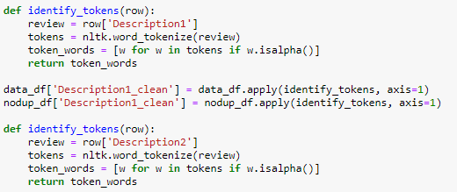
Preprocessing: Tokenization
['in', 'the', 'example', 'page', 'see', 'url', 'i', 'have', 'tried', 'to', 'vertically', 'align', 'all', 'the', 'cells','using', 'col', 'valigntop', 'mac', 'mozilla', 'and', 'win', 'firefox', 'both', 'demonstrate', 'this','problem', 'so', 'it', 'seems', 'to', 'be', 'quite', 'an', 'old', 'issue', 'it', 'might', 'be', 'related', 'to','bug', 'though', 'i', 'dont', 'believe', 'that', 'dealt', 'with', 'valign', 'the', 'page', 'also', 'shows', 'that','col', 'wont', 'apply', 'background', 'colours', 'to', 'cells', 'either', 'as', 'well', 'as', 'not','supporting', 'valign', 'the', 'whole', 'left', 'column', 'is', 'meant', 'to', 'be', 'green', 'but','mozfirefox', 'wont', 'display', 'the', 'colour', 'this', 'is', 'possibly', 'bug', 'i', 'have', 'tried', 'to','use','css', 'instead', 'using', 'verticalalign', 'instead', 'of', 'valign', 'i', 'tried', 'applying','styleverticalalign', 'top', 'to', 'the', 'col', 'tags', 'as', 'a', 'workaround', 'in', 'case', 'this','issue', 'is', 'due', 'to', 'a', 'lack', 'of', 'support', 'for', 'outdated', 'html', 'properties', 'and', 'this','did', 'not', 'work', 'either', 'col', 'seems', 'to', 'not', 'apply', 'any', 'formatting', 'to', 'cells','whatsoever', 'neither', 'css', 'nor', 'html', 'microsoft', 'ie','for', 'the', 'macintosh', 'also','displays', 'the', 'valign', 'issue', 'no', 'support', 'for', 'either', 'form', 'of', 'vertical', 'alignment','in', 'col', 'but','icab', 'b', 'mac', 'browser', 'handles', 'valign', 'correctly', 'not', 'tried','it','with', 'verticalalign', 'as', 'its', 'css', 'support', 'is', 'lacking','i', 'assume', 'that', 'there', 'is','some', 'workaround', 'using', 'css', 'styles','applied', 'to', 'table', 'cells', 'but', 'i', 'can', 'not', 'get','any', 'styles', 'to', 'apply', 'to', 'the', 'middle', 'table', 'cells', 'alas', 'its', 'beyond', 'me', 'at', 'the','moment', 'but', 'in', 'case', 'i', 'do','thats', 'why', 'ive', 'preserved', 'open', 'page', 'in', 'mozilla','or', 'firefox','the', 'page', 'doesnt', 'look', 'right', 'lack', 'of', 'top', 'vertical', 'alignment', 'and','lack', 'of', 'other', 'formatting', 'in', 'the', 'centre', 'content', 'table', 'made', 'it', 'look', 'right', 'all','columns', 'should', 'be', 'top', 'verticallyaligned']

Slide 8
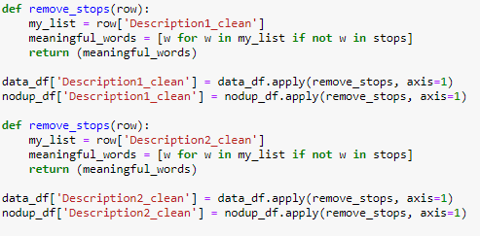
Preprocessing: Stop Word Removal
['example', 'page', 'see', 'url', 'tried', 'vertically', 'align', 'cells', 'using', 'col', 'valigntop','mac','mozilla', 'win', 'firefox', 'demonstrate', 'problem', 'seems', 'quite', 'old', 'issue','might', 'related', 'bug', 'though', 'dont', 'believe', 'dealt', 'valign', 'page', 'also', 'shows', 'col','wont', 'apply', 'background', 'colours', 'cells', 'either', 'well', 'supporting', 'valign', 'whole', 'left','column', 'meant', 'green', 'mozfirefox', 'wont', 'display', 'colour', 'possibly', 'bug', 'tried', 'use','css', 'instead', 'using', 'verticalalign', 'instead', 'valign', 'tried', 'applying', 'styleverticalalign','top', 'col', 'tags', 'workaround', 'case', 'issue', 'due', 'lack', 'support', 'outdated','html', 'properties', 'work', 'either', 'col', 'seems', 'apply', 'formatting', 'cells', 'whatsoever','neither', 'css', 'html', 'microsoft', 'ie', 'macintosh', 'also', 'displays', 'valign', 'issue','support', 'either', 'form', 'vertical', 'alignment', 'col', 'icab', 'b', 'mac', 'browser', 'handles','valign', 'correctly', 'tried', 'verticalalign', 'css', 'support', 'lacking', 'assume', 'workaround','using', 'css', 'styles', 'applied', 'table', 'cells', 'get', 'styles', 'apply', 'middle', 'table','cells', 'alas', 'beyond', 'moment', 'case', 'thats', 'ive', 'preserved', 'open', 'page', 'mozilla','firefox', 'page', 'doesnt', 'look', 'right', 'lack', 'top', 'vertical', 'alignment', 'lack', 'formatting','centre', 'content', 'table', 'made', 'look', 'right', 'columns', 'top', 'verticallyaligned']

Slide 9
Preprocessing: Lemmatization
example page see url tried vertical align cells using col valigntop mac mozilla win firefox demonstrate problem seem quite old issue might related bug though dont believe dealt valign page also shows col wont apply background colours cells either well support valign whole left column meant green mozfirefox wont display colour possibly bug tried use css instead verticalalign instead valign tried apply styleverticalalign top col tags workaround case issue due lack support outdated html properties work either col seems apply formatting cells whatsoever neither css html microsoft ie macintosh also displays valign issue support either form vertical alignment col icab b mac browser handles valign correctly tried verticalalign css support lacking assume workaround using css styles applied table cells get styles apply middle table cells alas beyond moment case thats ive preserved open page mozilla firefox page doesnt look right lack top vertical alignment lack formatting centre content table made look right columns top verticallyaligned

Slide 10
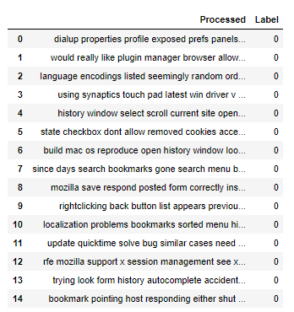
Preprocessing: Combining the Title and Description back
Once all the preprocessing is complete, the Title_1, Title_2, Description_1 and Description_2 are combined back together and their label is displayed beside them
This forms the basis of the input layer for the multichannel CNN that is to be deployed

Slide 11
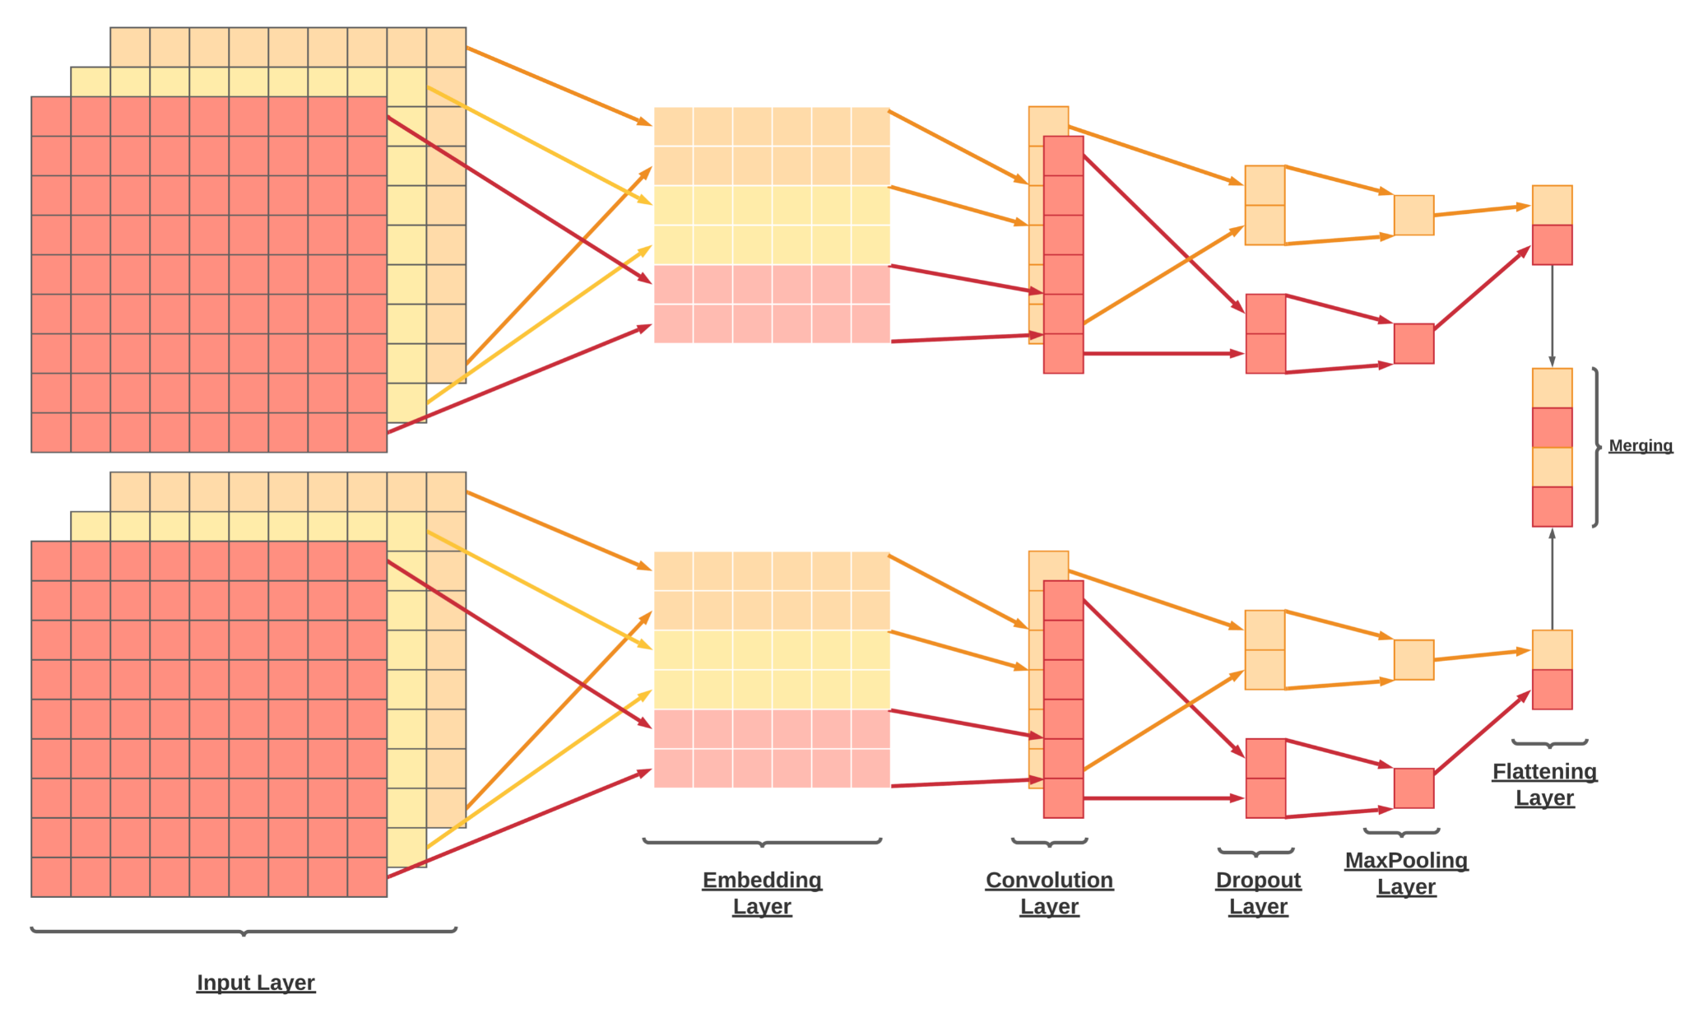
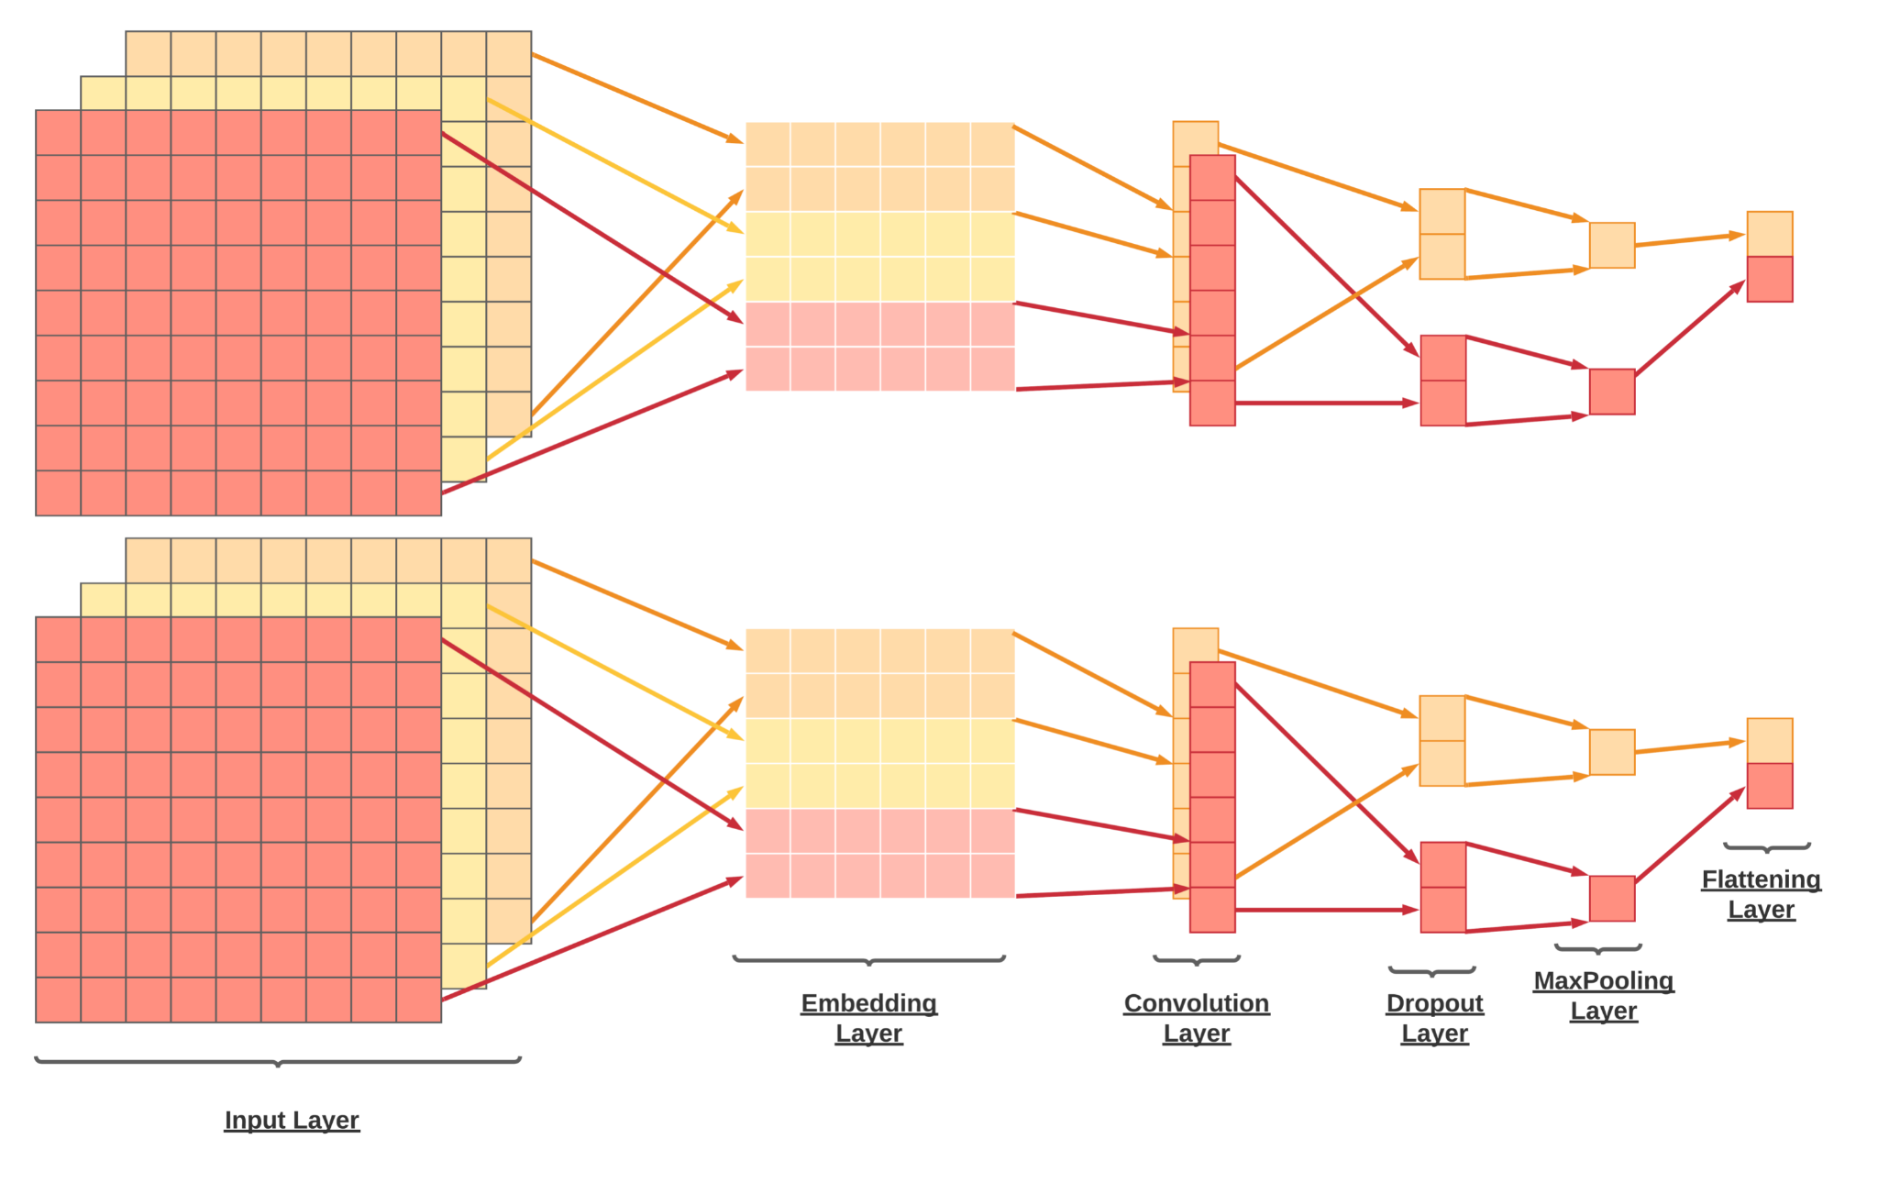
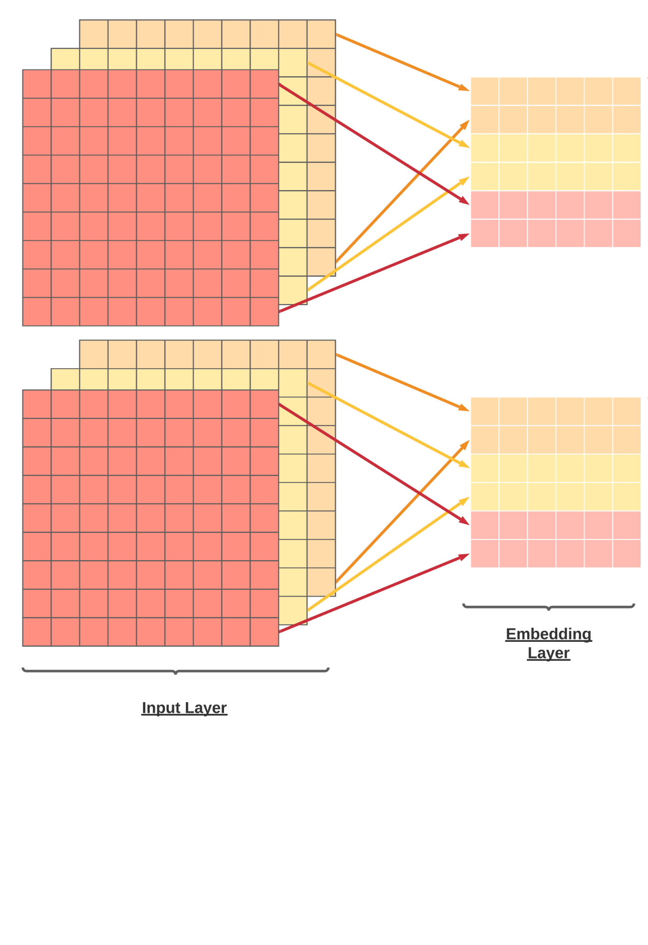
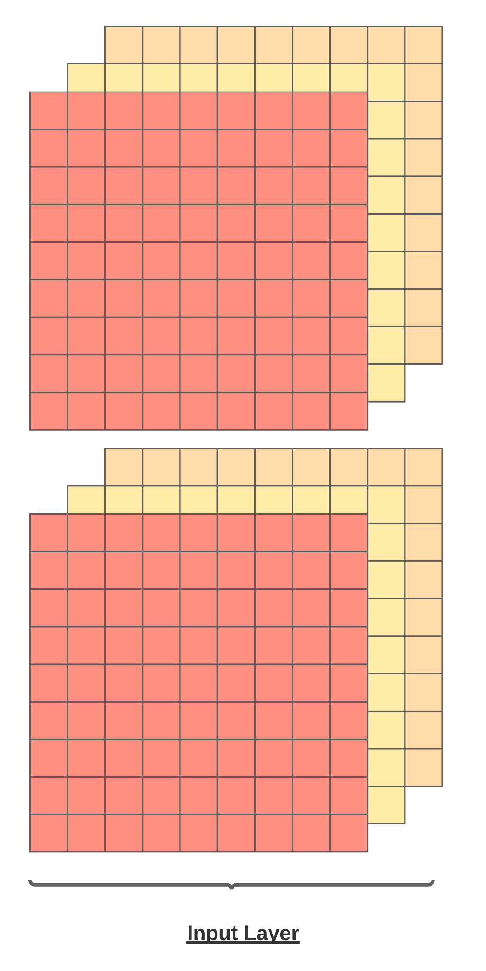
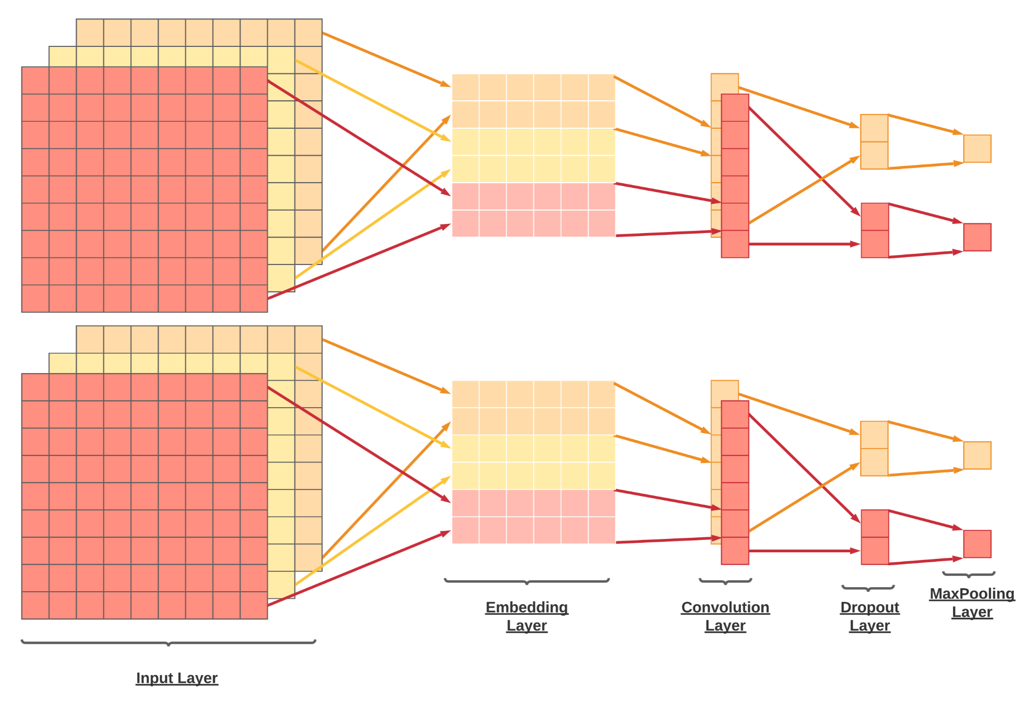
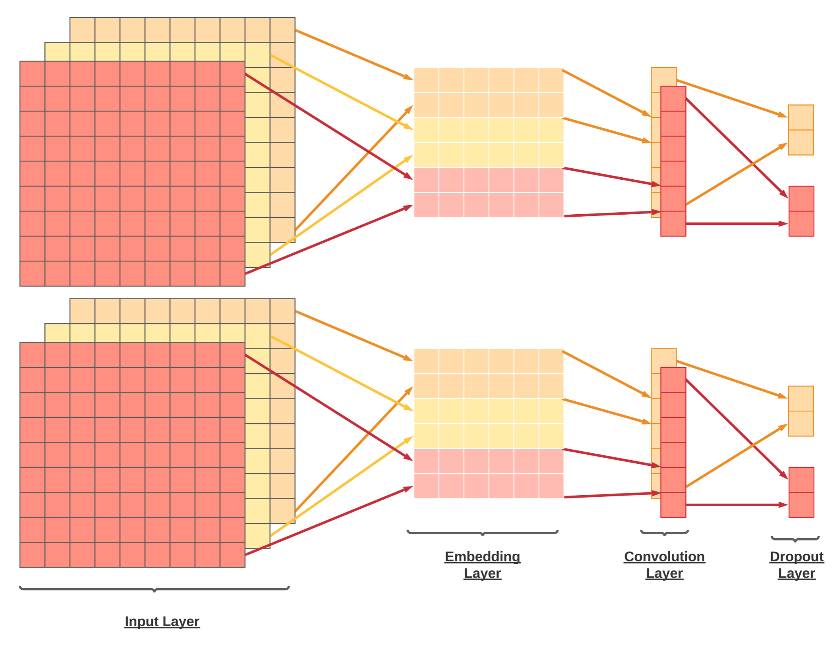
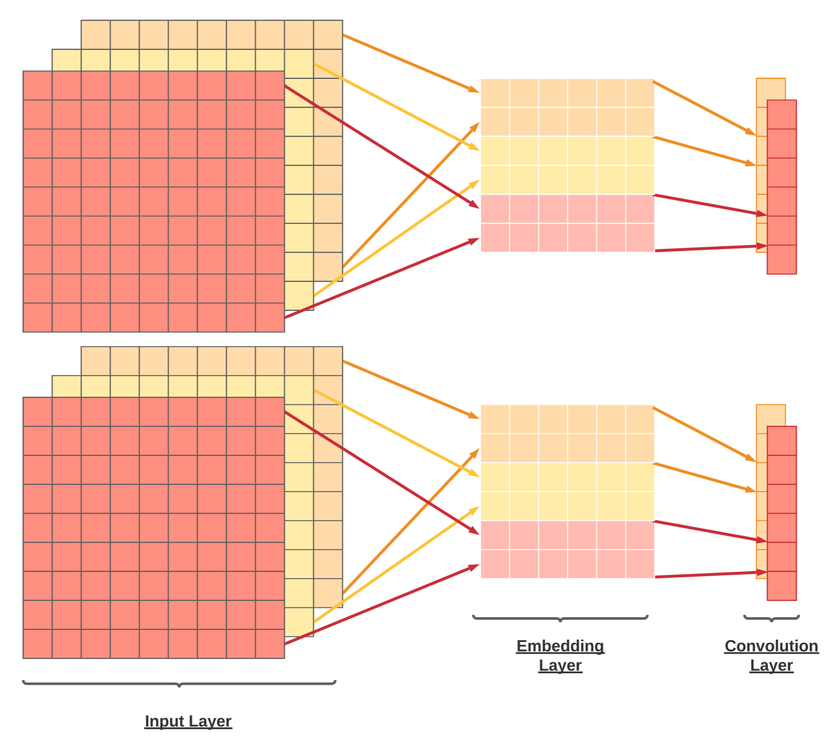
Whitebox Diagram

Slide 12
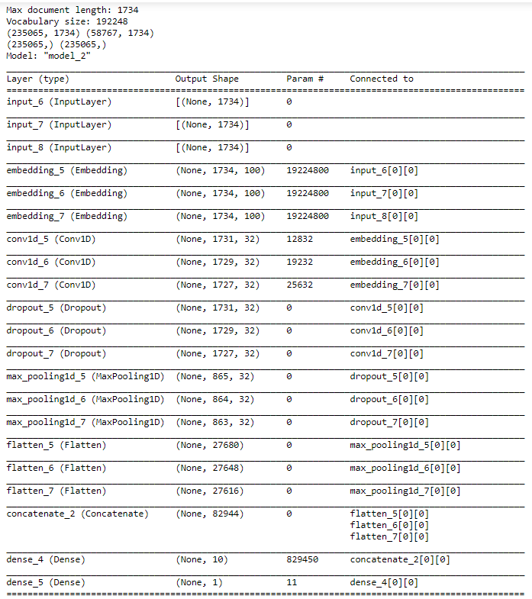
Whitebox Diagram
Multichannel CNN is deployed using keras
We made the model run through 3 epochs
Each epoch took an average of 50 minutes when ran multiple times

Slide 13
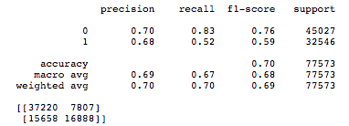
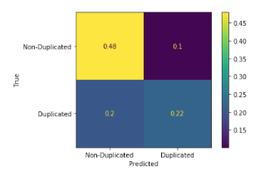
Validation
How is the Logistic Regression performed for Title & Description fields for all three datasets?
TP = 0.22 suggested that the algorithm predict that Title & Description fields are correctly label as duplicated and they actually are duplicate.
TN = 0.48 suggested that the algorithm predicted non-duplicate and they are actually not duplicate.
FP (Type I Error) suggested that when Title & Description fields are actually non-duplicated, there is 0.1 probability that it predicts as duplicated.
FN (Type II Error) suggested that when Title & Description fields are duplicated, there is a 0.2 probability that it predicts as non-duplicate. (More Serious! )

Slide 14
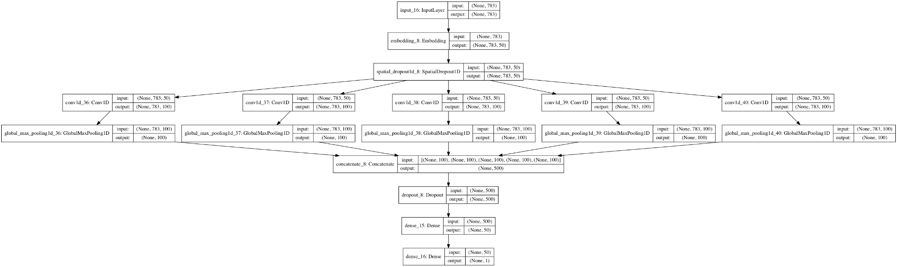
Validation
How is our Multi Channel model defined?
Input layer that defines the length of input sequences.
Embedding layer set to the size of the vocabulary and 100-dimensional real-valued representations.
One-dimensional convolutional layer with 32 filters and a kernel size set to the number of words to read at once.
Max Pooling layer has consolidated and flatten layer reduce from three-dimensional to two dimensional output.

Slide 15
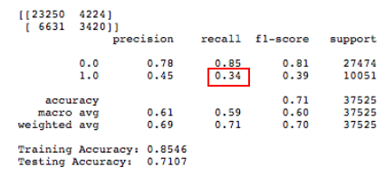
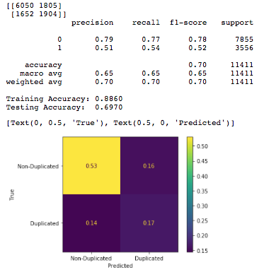
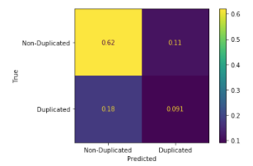
Validation
Performance of MC-CNN on ThunderBird and Eclipse Dataset (Include Title and Description Fields)
Eclipse
ThunderBird

Slide 16
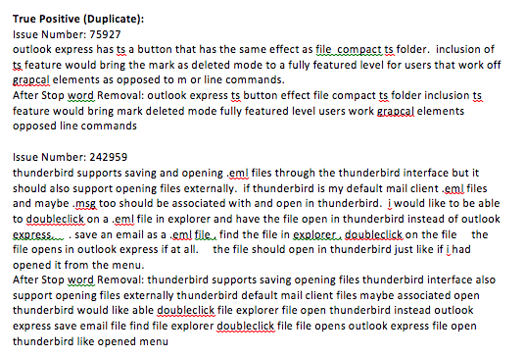
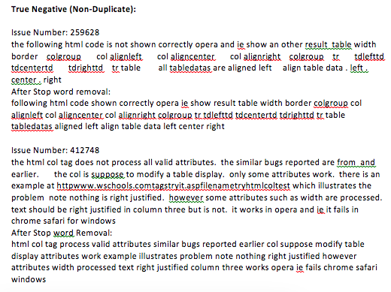
The actual value was positive and the model predicted label ‘1’ value. The actual value was 0 and the model predicted label ‘0’ value.

Slide 17
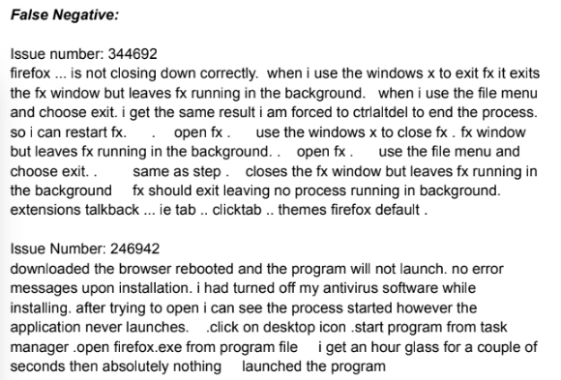
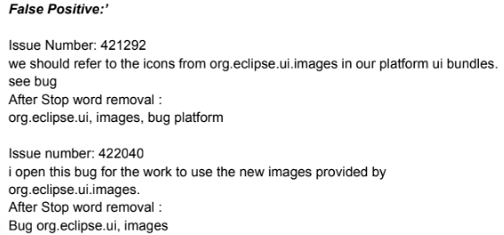
The actual value was 0 and the model predicted label ‘1’ value. The actual value was duplicated and the model predicted label ‘0’ value. (Type I Error) (Type II Error)

Slide 18
Limitations and Future Improvements
Can prove to be expensive as there is a lot of computation time.
Feature selection can prove to be a bottleneck.
May need additional features in case of score saturation.
Solve the class imbalance problem in the data.

